Slide 1



DF REALTY

Slide 2
Development Overview
1
Project Name |  | Ara Grove by Epicon
Developer |  | Epicon Land Sdn Bhd
Property Type |  | 1 Storey Terrace House (20’x65’)
Land Tenure |  | 72.14 acres
Land Tenure |  | Freehold / Individual Title
Total Units |  | 879 units Phase 1 (37.54 acres) – 301 units Phase 2 – 292 units Phase 3 – 286 units
Estimated Completion |  | 36 construction months expected 2029
DF REALTY

Slide 3


About Ara Grove by Epicon
2
Batang Kali is a peaceful township in Hulu Selangor, surrounded by greenery and known for its relaxing small-town lifestyle. With good connectivity and convenient access to daily amenities, it offers families a balanced living environment between nature and city convenience. Its close distance to Genting Highlands also makes it an attractive location for weekend leisure and recreation.
DF REALTY
Ara Grove by Epicon is a tranquil residential development set within a lush green environment, designed as a calm retreat from busy city life. Covering approximately 72.14 acres, the development features 879 single-storey terrace homes planned for comfortable family living. At the heart of the community is a central park where residents can relax, connect, and enjoy nature together. Ara Grove is more than just a housing development — it is a place where families can create lasting memories and enjoy a peaceful lifestyle.

Slide 4
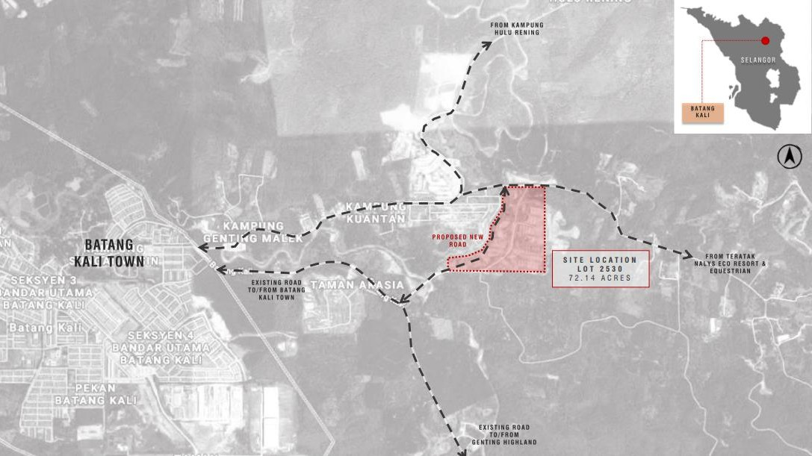

Location
5
Location
7/31/2026
DF REALTY

Slide 5
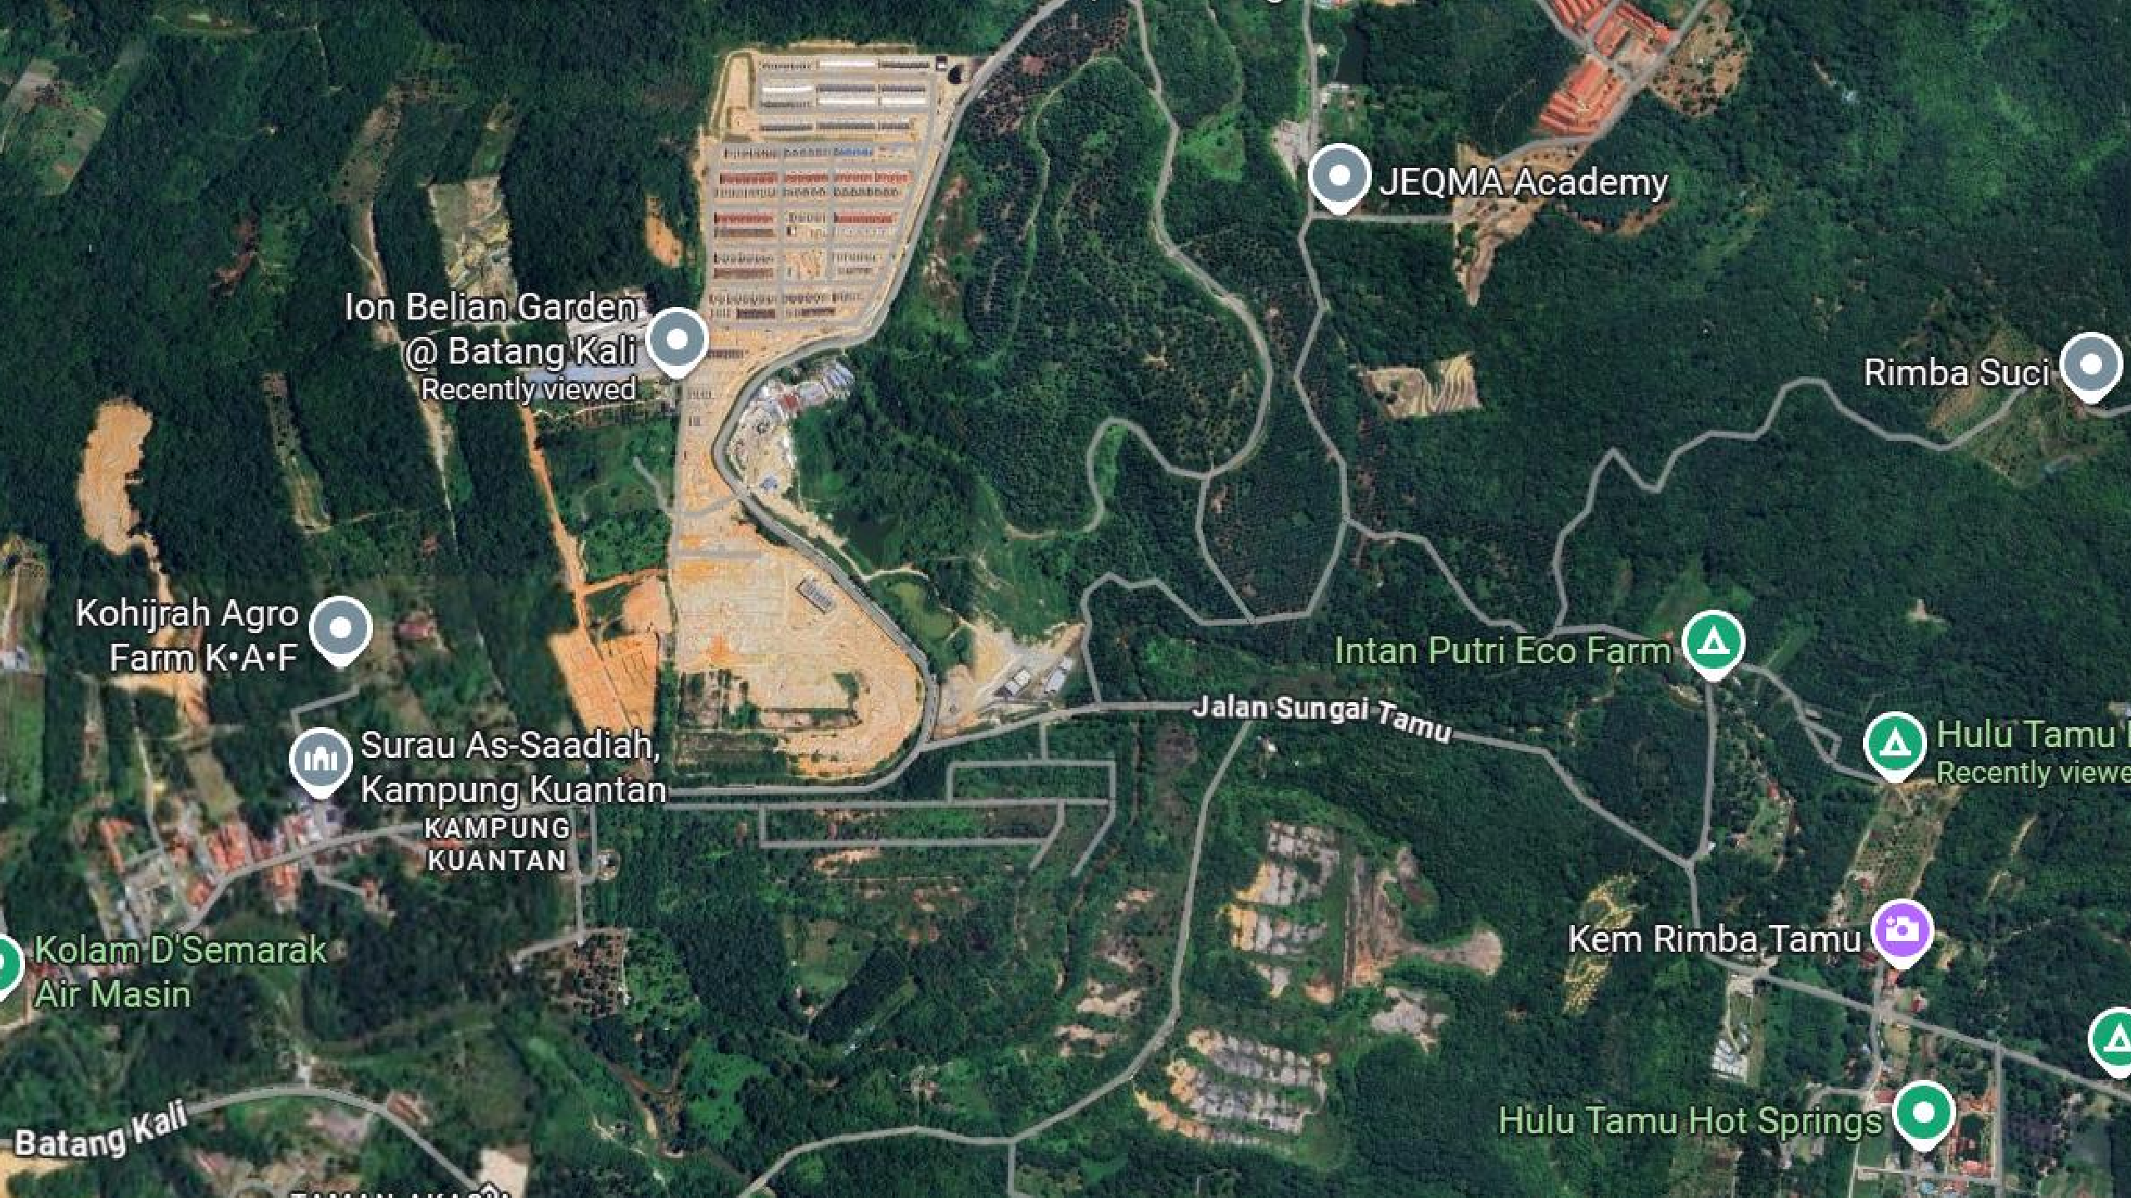




Site Location – Google Map
DF REALTY
3°28'10.7"N 101°41'11.7"E

Slide 6
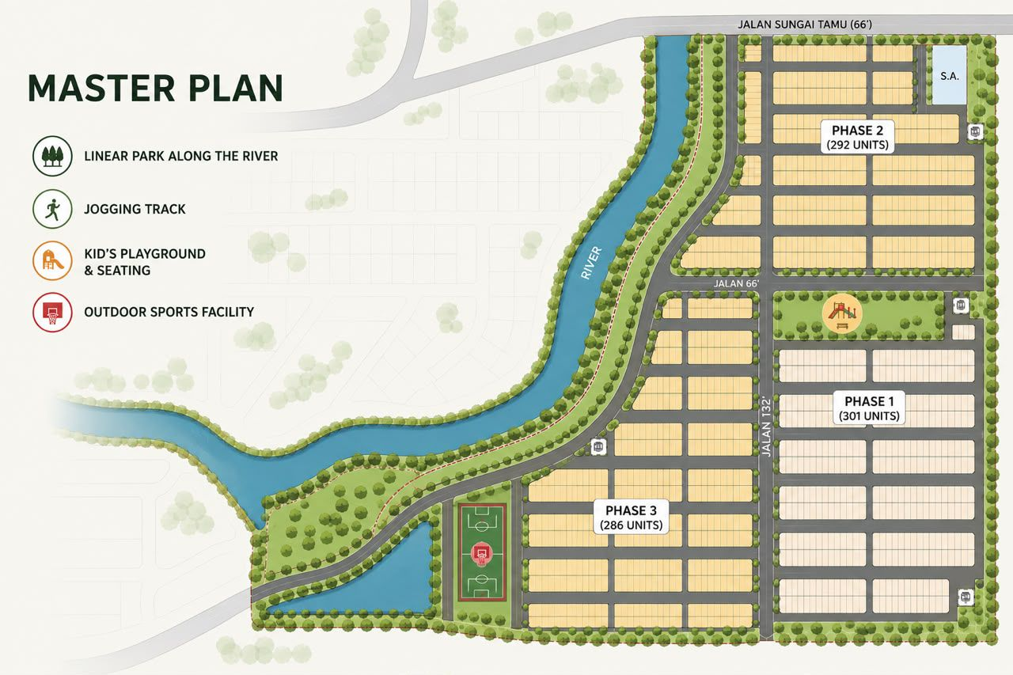





Masterplan
DF REALTY

Slide 7
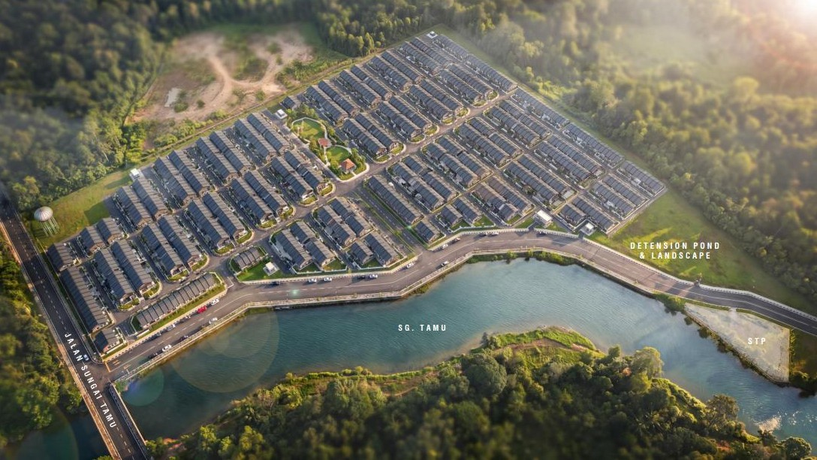


Masterplan
Masterplan
DF REALTY

Slide 8

Unique Selling Point
8
Unmatched Entry Price for Landed Living
Own a freehold landed home from just RM330,000* — one of the most accessible price points in Northern Selangor, making landed property ownership finally achievable for first-time buyers and upgraders.
True Ownership, Total Freedom
Freehold with individual title — enjoy full control to extend, renovate, and personalize your home with no maintenance fees holding you back.
Live Within an Established Township
Strategically located near everyday essentials including schools, supermarkets like Econsave, and a growing mix of eateries — giving you convenience without the chaos of the city.
DF REALTY

Slide 9
Unique Selling Point
9
DF REALTY
Nature-Rich Living, City-Connected
Nestled at the foothills of the Titiwangsa Range, enjoy cooler air, greener surroundings, and a peaceful low-density environment. Minutes away from eco-destinations like Hulu Tamu Hot Springs, riverside retreats, and glamping sites — offering a lifestyle that blends relaxation with adventure.
5. Smart, Fully-Extended Layout — Move-In Ready
Designed with a practical, fully extended layout, maximizing built-up space from day one — helping you save on renovation costs and move in comfortably without major upgrades.

Slide 10
Amenities
11
Accessibilities | Distance (KM) | Schools | Distance (KM)
Rawang Bypass | 24.3km | SK Kampung Kuantan | 1.4km
LATAR Highway Bank & Services | 35.4km | SMK Bandar Baru Batang Kali SK Bandar Baru Batang Kali SMK Syed Mashor | 4.5km 4.5km 4.8km
Pos Office | 5.0km | SJKT Batang Kali | 5.0km
Police Station | 6.0km | Hulu Selangor Community College | 5.9km
Public Bank | 6.3km | SJK (c) Batang Kali | 6.3km
Petrol Station Shell | 4.1km | Grocery 99 Speedmart | 4.5km
Petronas | 4.4km | Econsave | 4.6km
Caltex | 5.5km | Eco-Shop | 5.3km
DF REALTY

Slide 11
Amenities
12
Transportation | Distance (KM) | Hot Spot | Distance (KM)
KTM Batang Kali | 6.4km | Hulu Tamu Hot Springs | 1.7km
LATAR Highway | 35.4km | Genting Premium Outlet | 23.7km
 |  | Genting Highlands | 30.7km
Restaurant
KFC | 4.5km | Mosque/Surau | Distance (KM)
Pizza Hut | 4.5km | Surau As-Saadiah | 1.4km
Domino’s Pizza | 4.5km | Surau al-Mustaqim | 2.9km
Secret Recipe | 4.5km | Masjid Jamek Sungai Masin | 3.9km
Marry Brown | 4.6km
DF REALTY

Slide 12
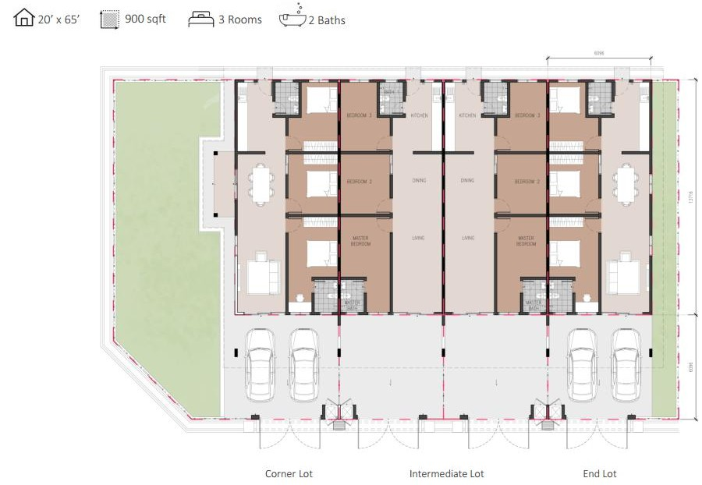
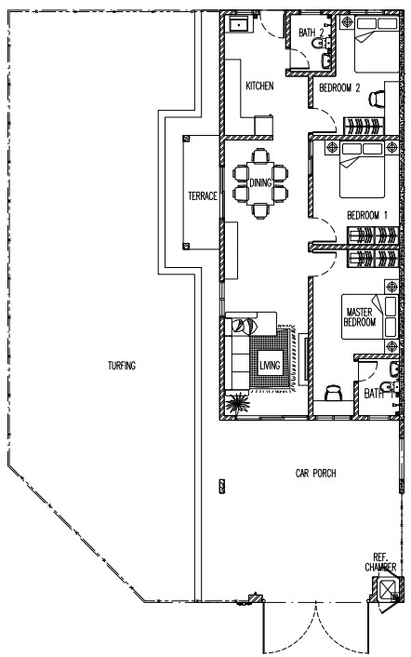
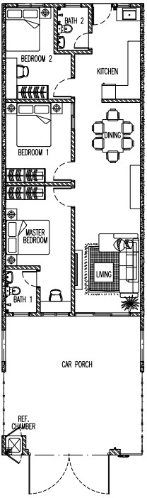
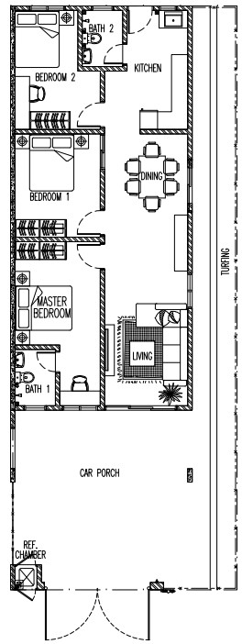

1279sf (C)
1213sf (E)
1103sf (I)
6096
13716
DF REALTY
6096
Layout Plan
1279sf
1103sf
1213sf

Slide 13
Sales Package
11
Proposed SPA Selling Price range
Intermediate Lot – RM330,000 ~ RM336,000
End Lot – RM356,000 ~ RM412,000
Corner Lot – RM428,000 – RM434,000
Sales Package
Booking Fees RM200 (to ‘DF REALTY SDN BHD’ (Cheque / Online Transfer / Credit card)
Rebate 10%
Free SPA legal fees & disbursement fees
Free Loan legal fees, stamp duty & disbursement fees
Free MOT stamp duty
Cancellation fully forfeiture if without bank rejection letter
Excess payment will be refunded upon VP (RM200 booking fees if loan obtained 90% margin)
DF REALTY

Slide 14
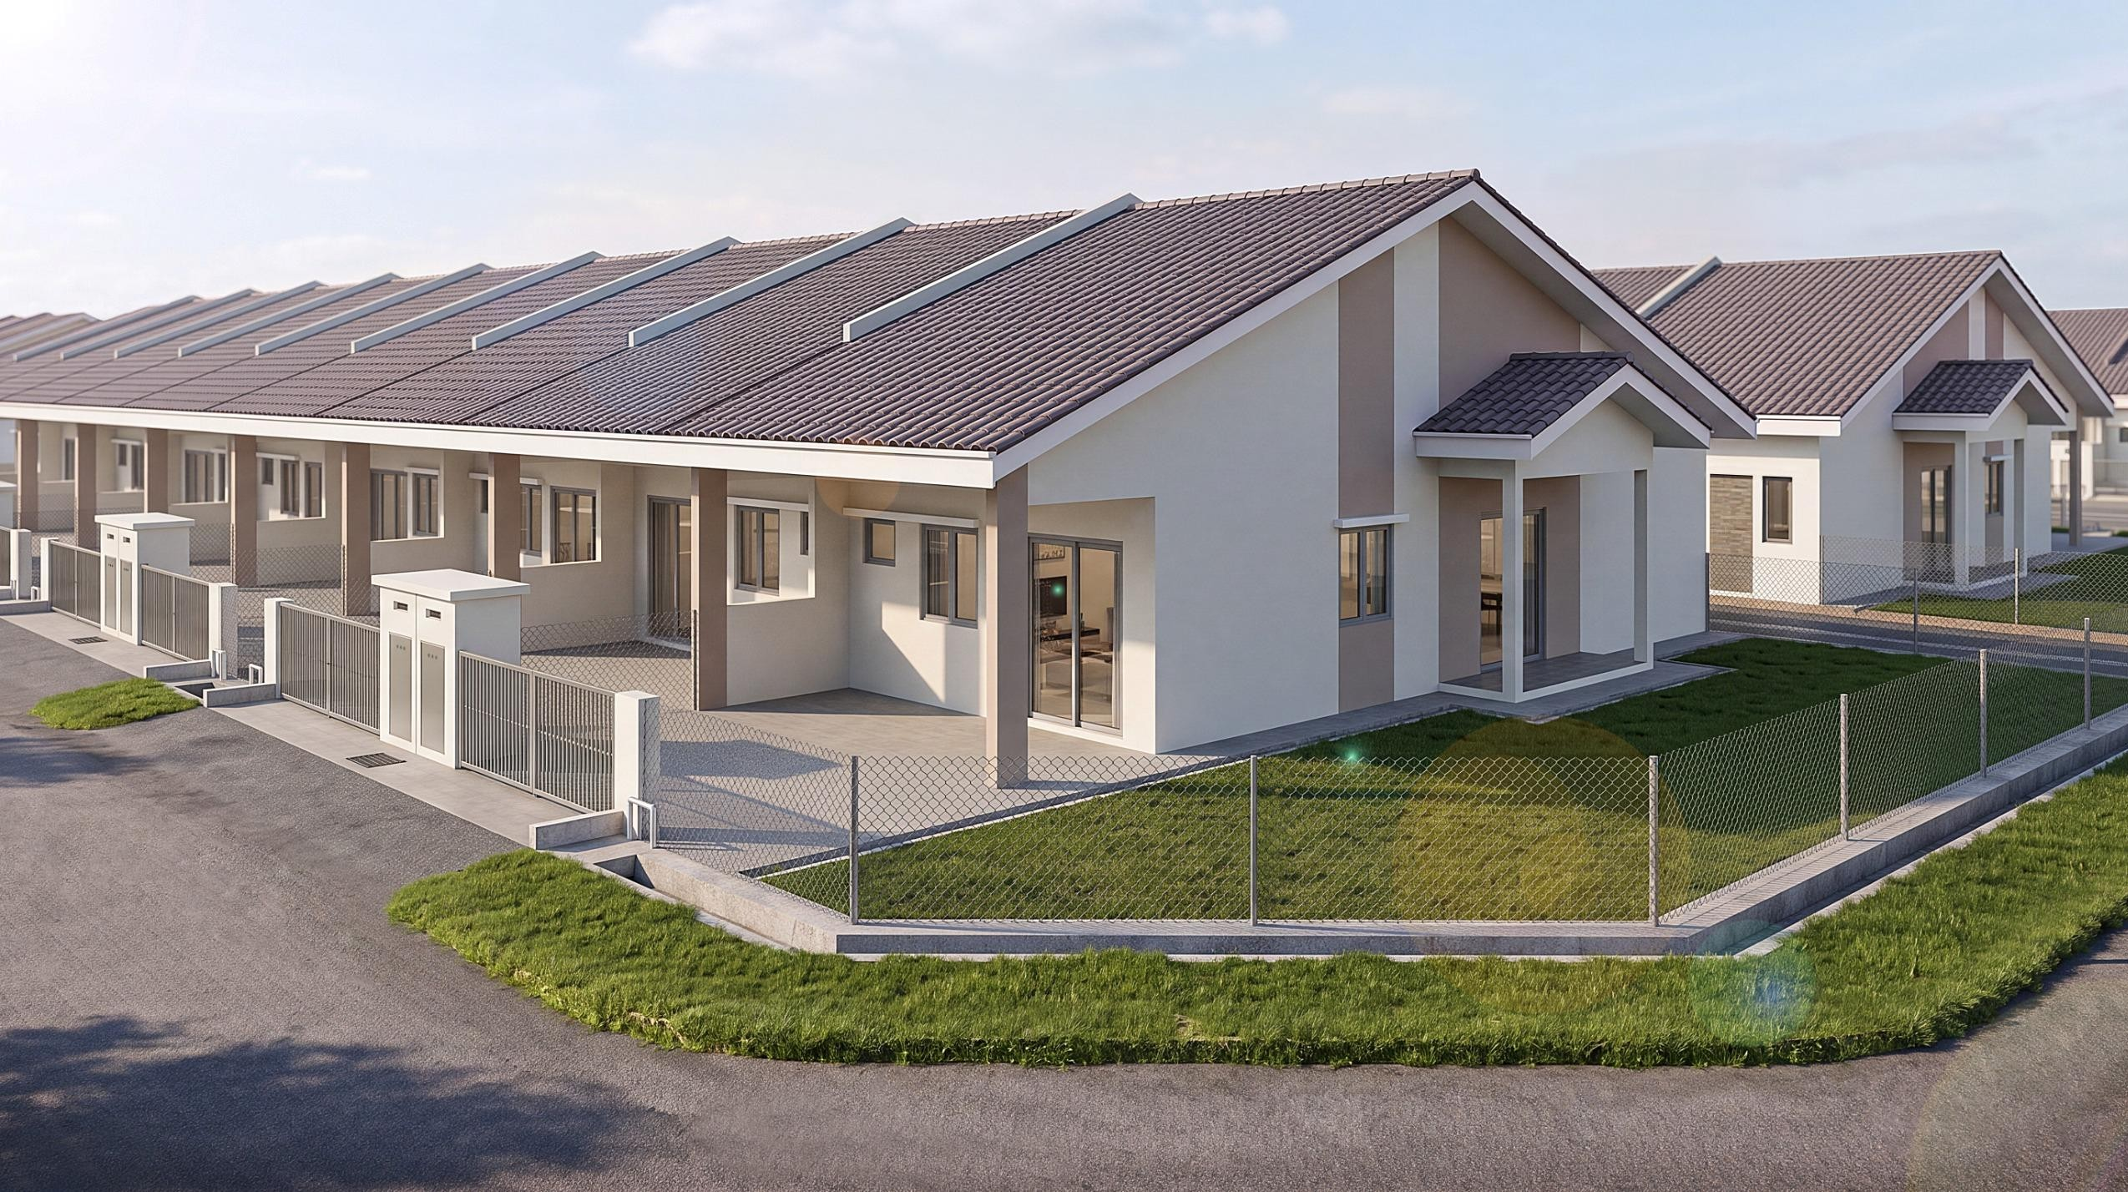





15
7/31/2026
DF REALTY
Perspective

Slide 15
Building Specification (Intermediate)
STRUCTURE | Reinforced Concrete Framework
ROOFING | Roof Tiles
WALL | Concrete Wall/ Brick Wall
CEILING | Skim Coat / Plaster Ceiling
WINDOWS | Casement Window / Top Hung Window / Sliding Window
DOORS Entrance Bedroom Kitchen Bathroom | Sliding Door Flush Door M.S. Door PVC Door
IRONMONGERY | Quality Lock Set
FLOOR FINISHES Living, Dining, Kitchen, Bedroom, Bathroom Car Porch, Driveway Other Area | Tiles Cement Render Cement Render
WALL FINISHES Kitchen Bathroom Other Area | Wall Tiles Up to 1500mm Height Wall Tiles Up to Ceiling Height Skim Coat / Cement Plaster / Paint
DF REALTY

Slide 16
Building Specification (Intermediate)
SANITARY FITTINGS Wash Basin Water Closet Shower Head Water Tap Kitchen Sink | 2 nos 2 nos 2 nos 3 nos 1 nos
ELECTRICAL POINTS Lighting Point Fan Point Socket Point Telephone Point TV Point | 10 nos 4 nos 8 nos 1 nos 1 nos
FENCING | M.S. Gate and Chain Link Fence
DF REALTY

Slide 17
Building Specification (End Lot)
STRUCTURE | Reinforced Concrete Framework
ROOFING | Roof Tiles
WALL | Concrete Wall/ Brick Wall
CEILING | Skim Coat / Plaster Ceiling
WINDOWS | Casement Window / Top Hung Window / Sliding Window
DOORS Entrance Bedroom Kitchen Bathroom Dining | Sliding Door Flush Door M.S. Door PVC Door Sliding Door
IRONMONGERY | Quality Lock Set
FLOOR FINISHES Living, Dining, Kitchen, Bedroom, Bathroom Car Porch, Driveway Other Area | Tiles Cement Render Cement Render
WALL FINISHES Kitchen Bathroom Other Area | Wall Tiles Up to 1500mm Height Wall Tiles Up to Ceiling Height Skim Coat / Cement Plaster / Paint
DF REALTY

Slide 18
Building Specification (End Lot)
SANITARY FITTINGS Wash Basin Water Closet Shower Head Water Tap Kitchen Sink | 2 nos 2 nos 2 nos 4 nos 1 nos
ELECTRICAL POINTS Lighting Point Fan Point Socket Point Telephone Point TV Point | 11 nos 4 nos 8 nos 1 nos 1 nos
FENCING | M.S. Gate and Chain Link Fence
DF REALTY

Slide 19
Building Specification (Corner Lot)
STRUCTURE | Reinforced Concrete Framework
ROOFING | Roof Tiles
WALL | Concrete Wall/ Brick Wall
CEILING | Skim Coat / Plaster Ceiling
WINDOWS | Casement Window / Top Hung Window / Sliding Window
DOORS Entrance Bedroom Kitchen Bathroom Terrace | Sliding Door Flush Door M.S. Door PVC Door Sliding Door
IRONMONGERY | Quality Lock Set
FLOOR FINISHES Living, Dining, Kitchen, Bedroom, Bathroom Car Porch, Driveway Other Area | Tiles Cement Render Cement Render
WALL FINISHES Kitchen Bathroom Other Area | Wall Tiles Up to 1500mm Height Wall Tiles Up to Ceiling Height Skim Coat / Cement Plaster / Paint
DF REALTY

Slide 20
Building Specification (Corner Lot)
SANITARY FITTINGS Wash Basin Water Closet Shower Head Water Tap Kitchen Sink | 2 nos 2 nos 2 nos 4 nos 1 nos
ELECTRICAL POINTS Lighting Point Fan Point Socket Point Telephone Point TV Point | 11 nos 4 nos 8 nos 1 nos 1 nos
FENCING | M.S. Gate and Chain Link Fence
DF REALTY

Slide 21




Thank you
DF REALTY

